Slide 1
Angular CLI
Overview
Lecture 1
By James(Jin) Wang
09/28/2019

Slide 2
Outline
Install and verify the Angular CLI
Creating a new application
Generating code from blueprints
Linting our code
Building an optimized app
Testing our app

Slide 3
Big Picture
  Overview:
  What motivated its creation?
  What are the benefits of the Angular CLI?
  Can we take it for a test drive?

Slide 4
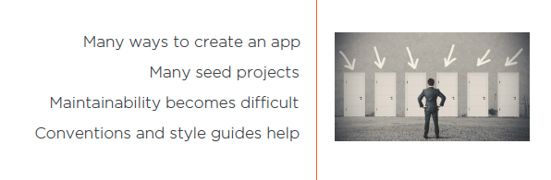
Motivation

Slide 5
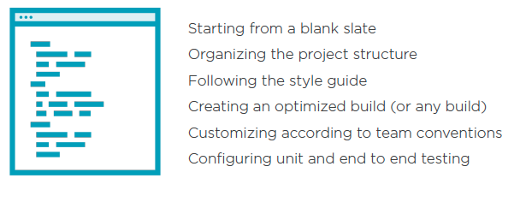
Motivation
  What makes starting a new app difficult?

Slide 6
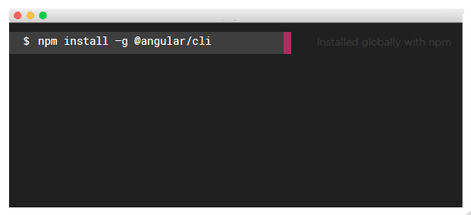
Look Inside the Angular CLI
  Installing the Angular CLI:

Slide 7
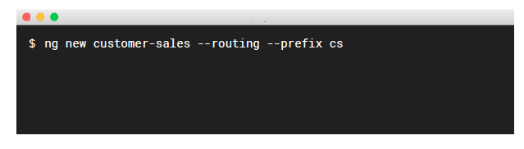
Look Inside the Angular CLI
  Generating a New Application:

Slide 8
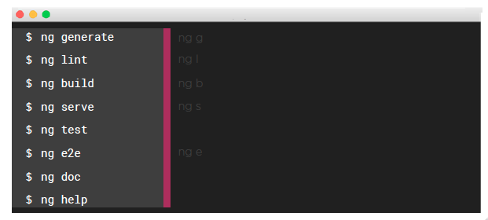
Look Inside the Angular CLI
  Angular CLI’s Main Commands:

Slide 9
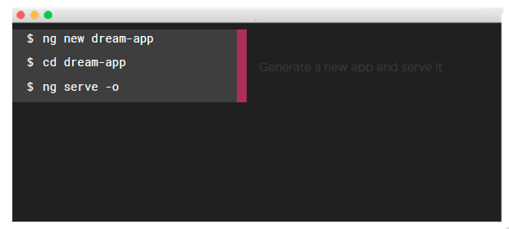
Look Inside the Angular CLI
  Test Driving the Angular CLI:

